Slide 1
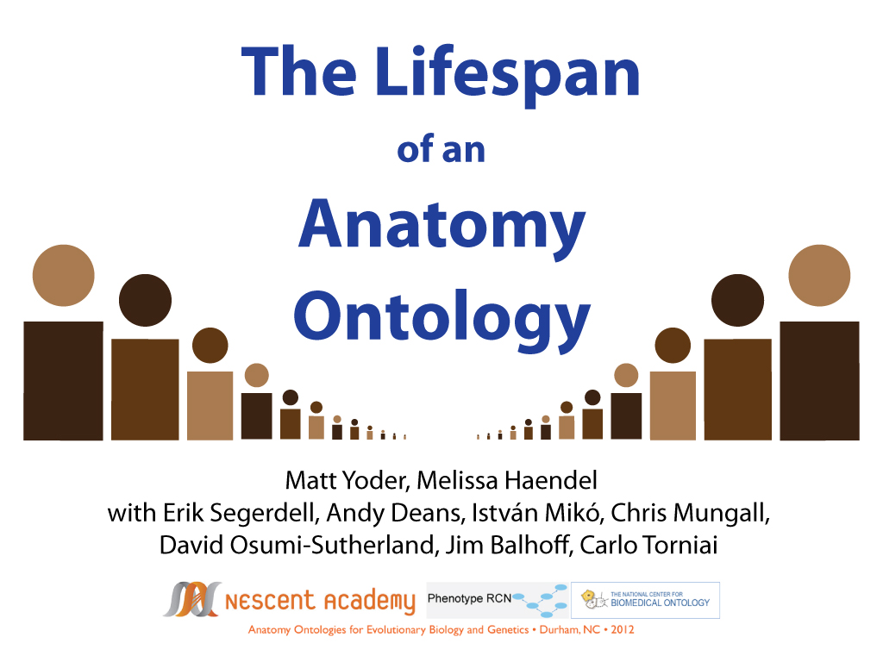

Slide 2
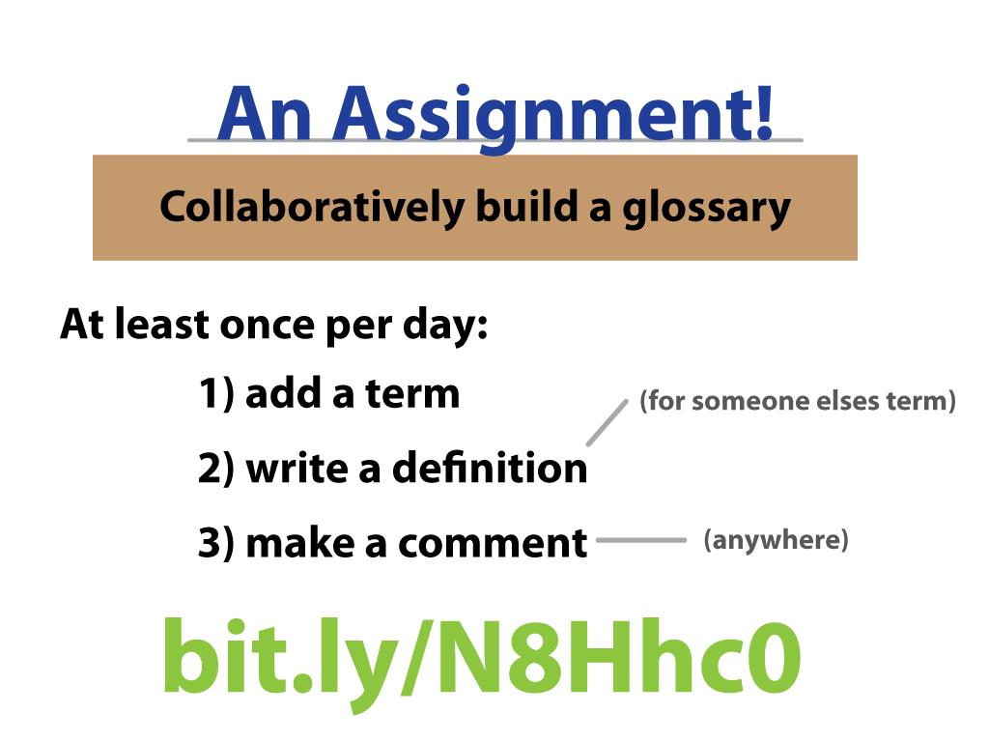

Slide 3
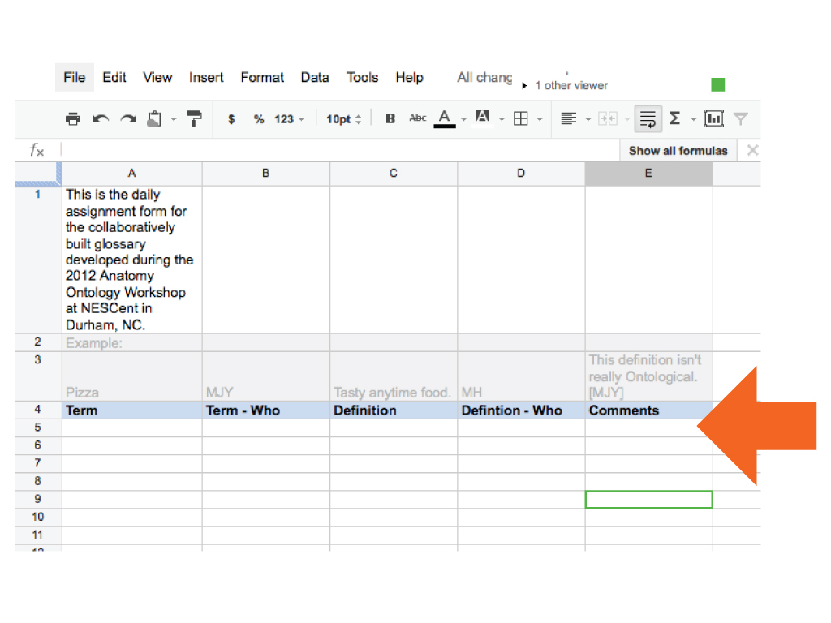

Slide 4
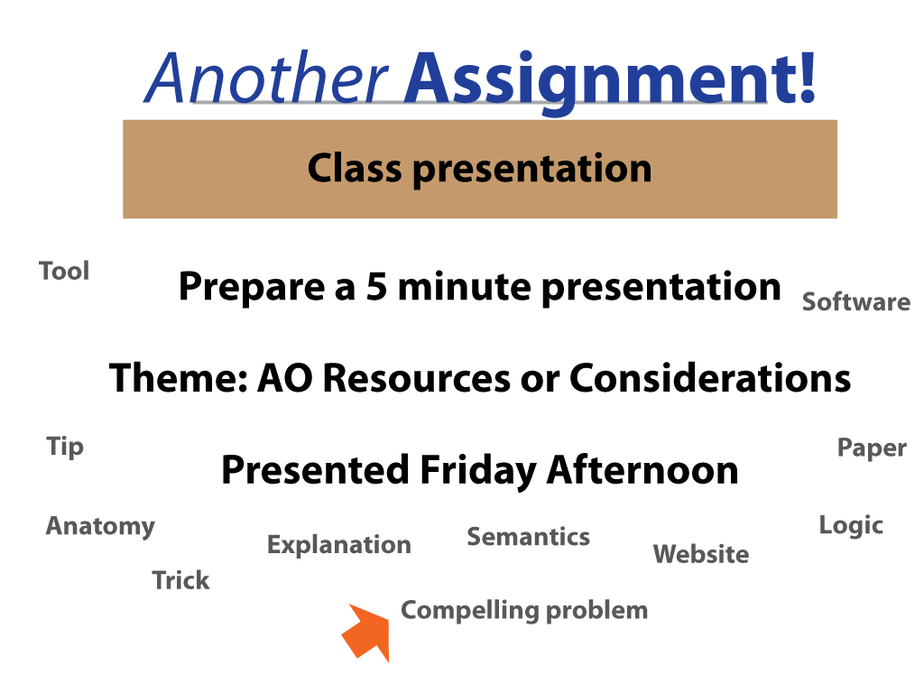

Slide 5
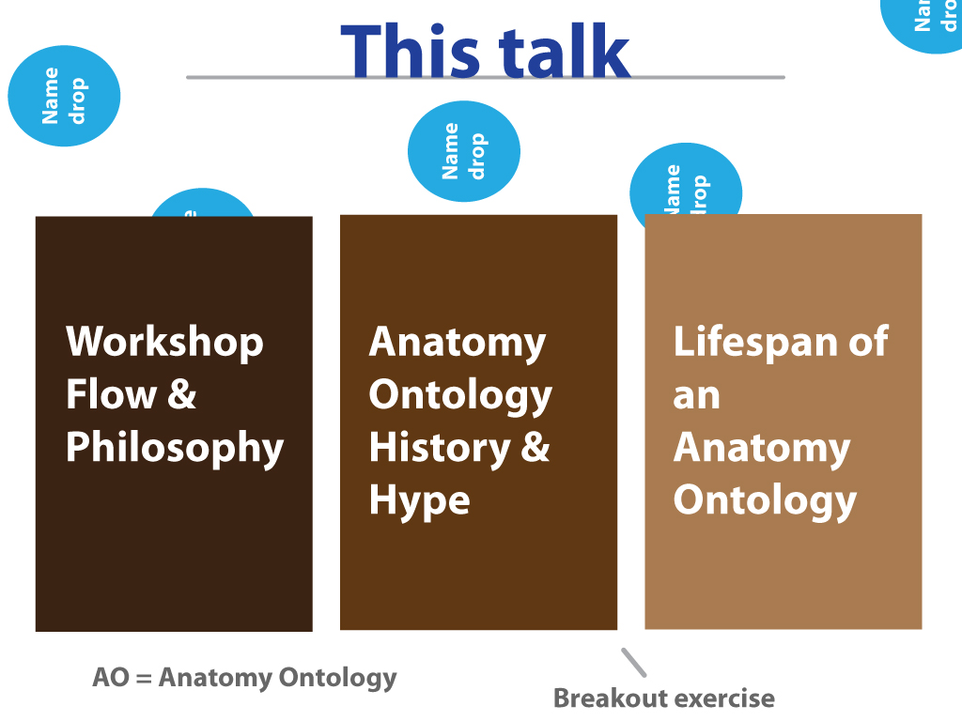

Slide 6
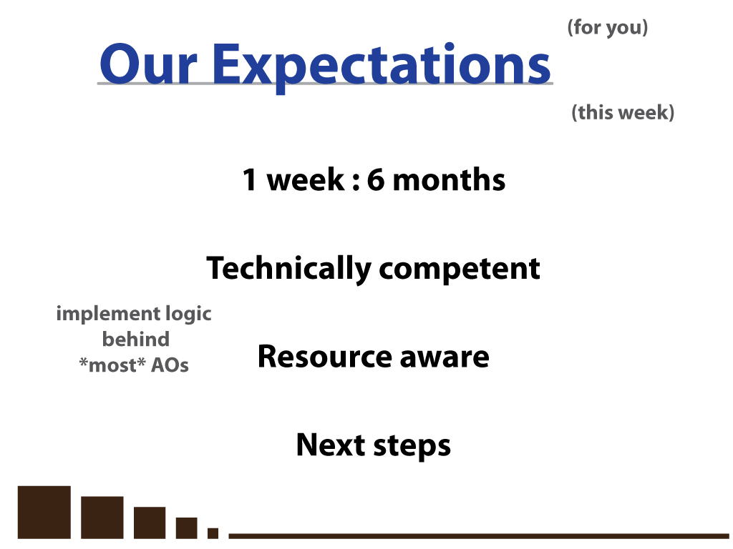

Slide 7
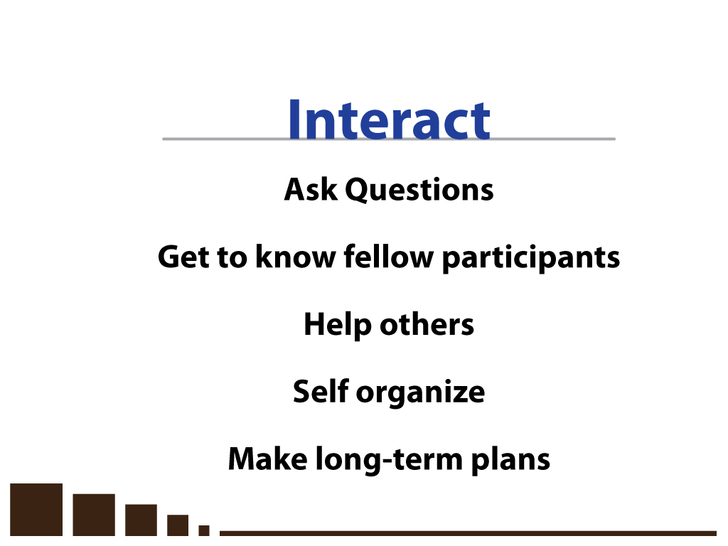

Slide 8
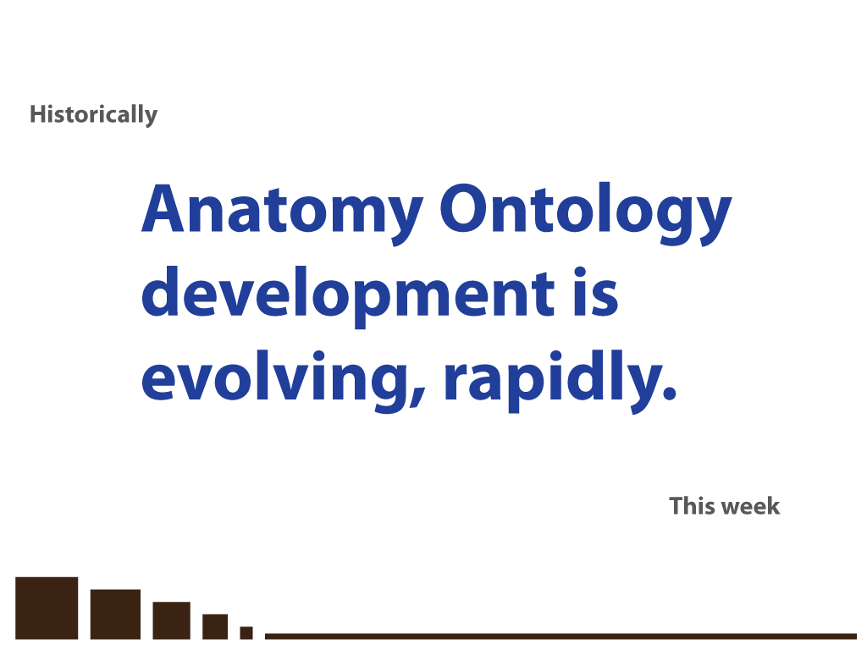

Slide 9
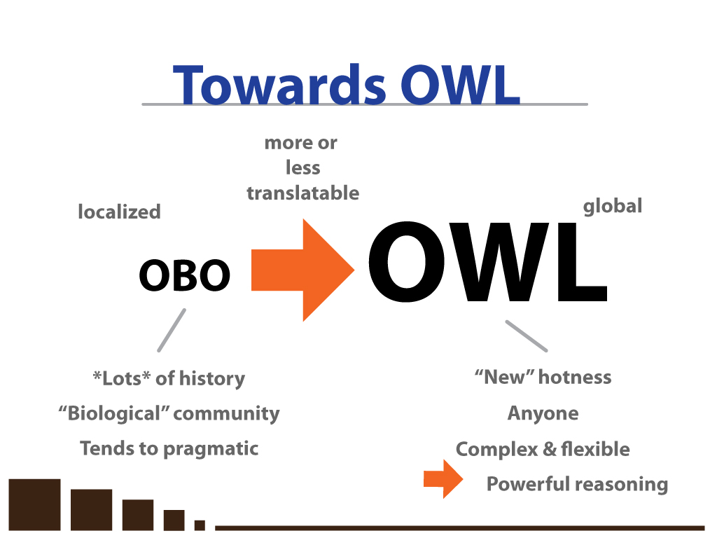

Slide 10
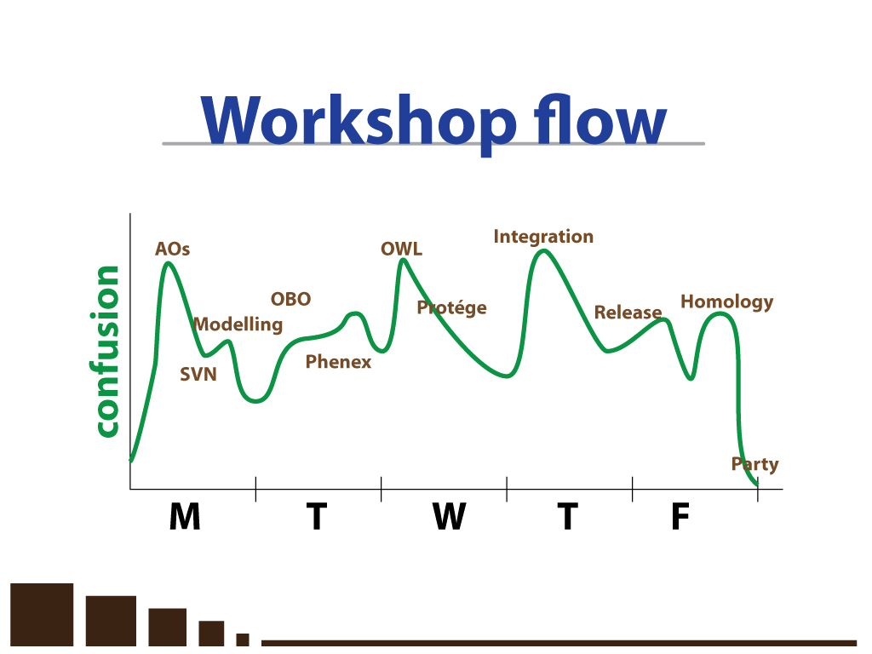

Slide 11
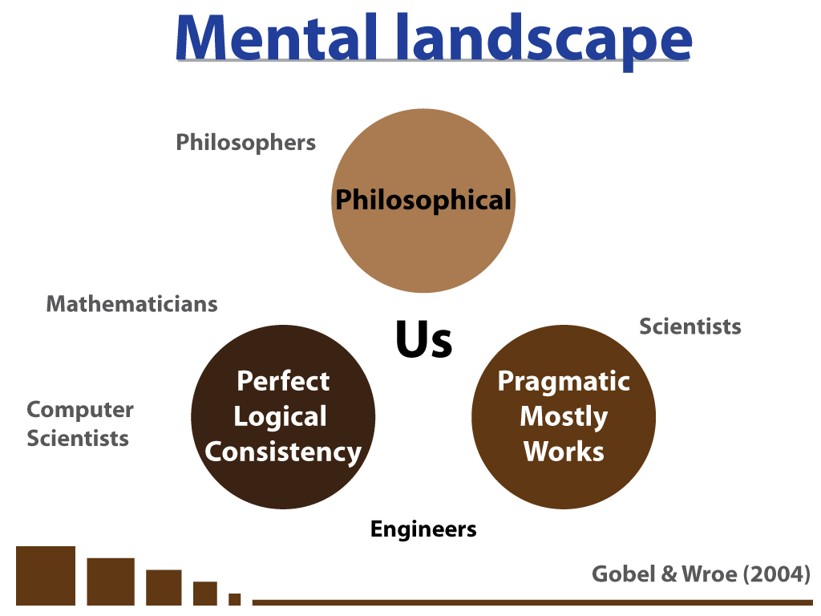

Slide 12
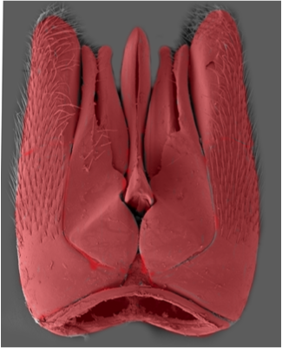
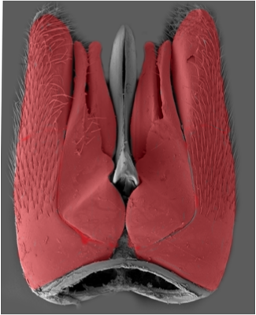
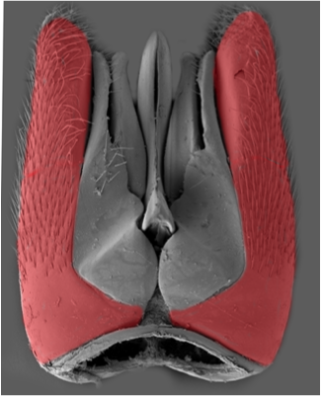
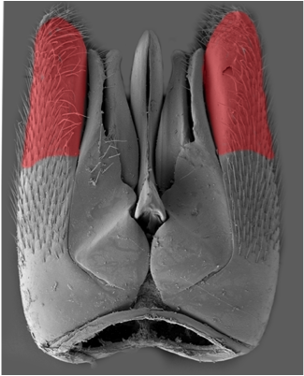
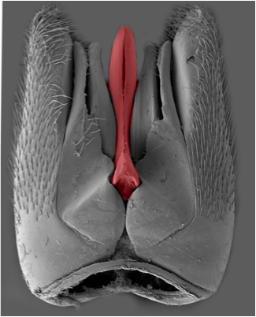
paramere?
Notes:
But because we have no single reference glossary the result is millions of statements that are not obviously related
here is the male genitalia of a gasteruptiid wasp.
these 5 different structures here have each been labeled "paramere" - by different people, studying different hymenopteran lineages

Slide 13

Anatomical information retrieval from text-based resources
OMIM Query | # Records
“large bone” | 785
“enlarged bone” | 156
“big bone” | 16
“huge bones” | 4
“massive bones” | 28
“hyperplastic bones” | 12
“hyperplastic bone” | 40
“bone hyperplasia” | 134
“increased bone growth” | 612
Less than ideal.

Slide 14
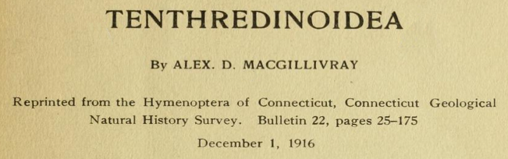
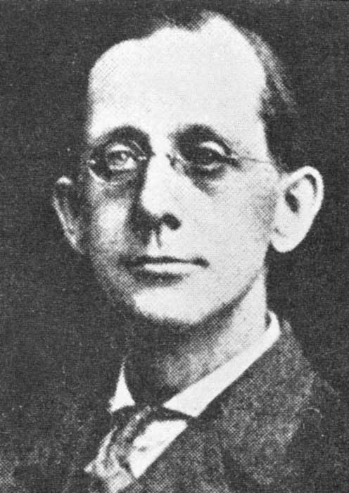
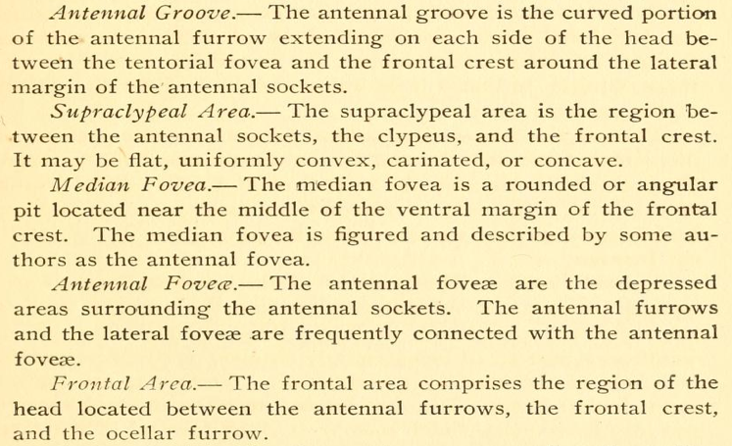

Slide 15
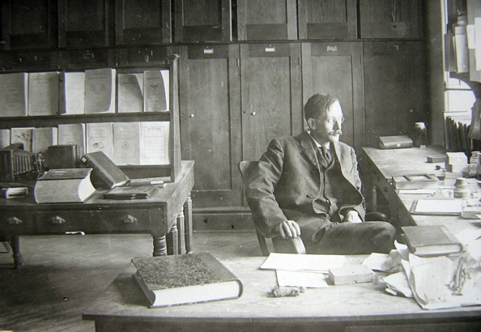
In this book there is rendered accessible to the entomologist ... the comparative external anatomy of insects, with clear-cut definitions and many illustrative examples. The attempt to reconcile the systems of nomenclature of the morphologist and of the systematist is most praiseworthy.
- Oskar A. Johannsen

Slide 16
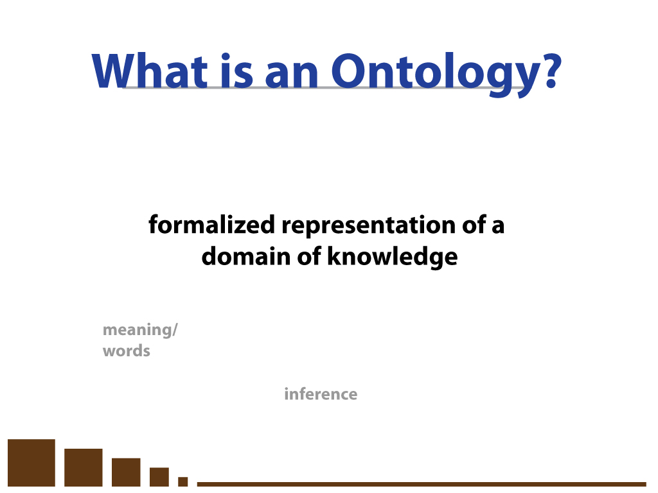

Slide 17
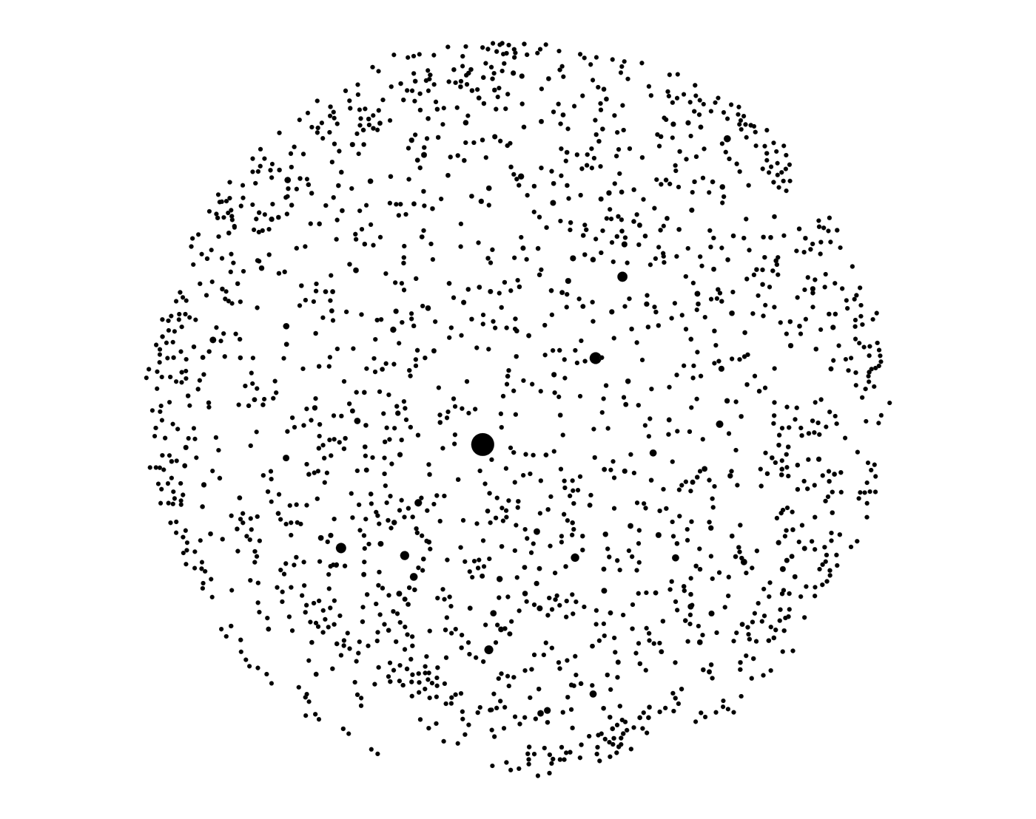

Slide 18
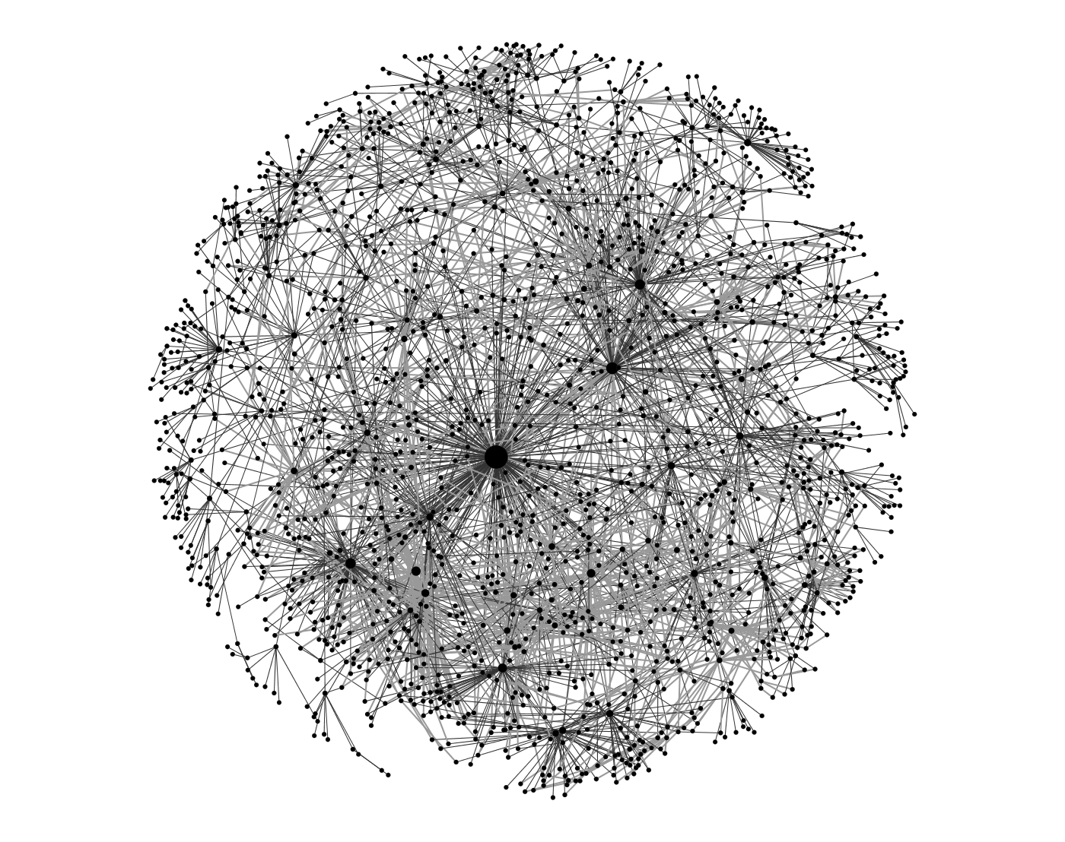

Slide 19
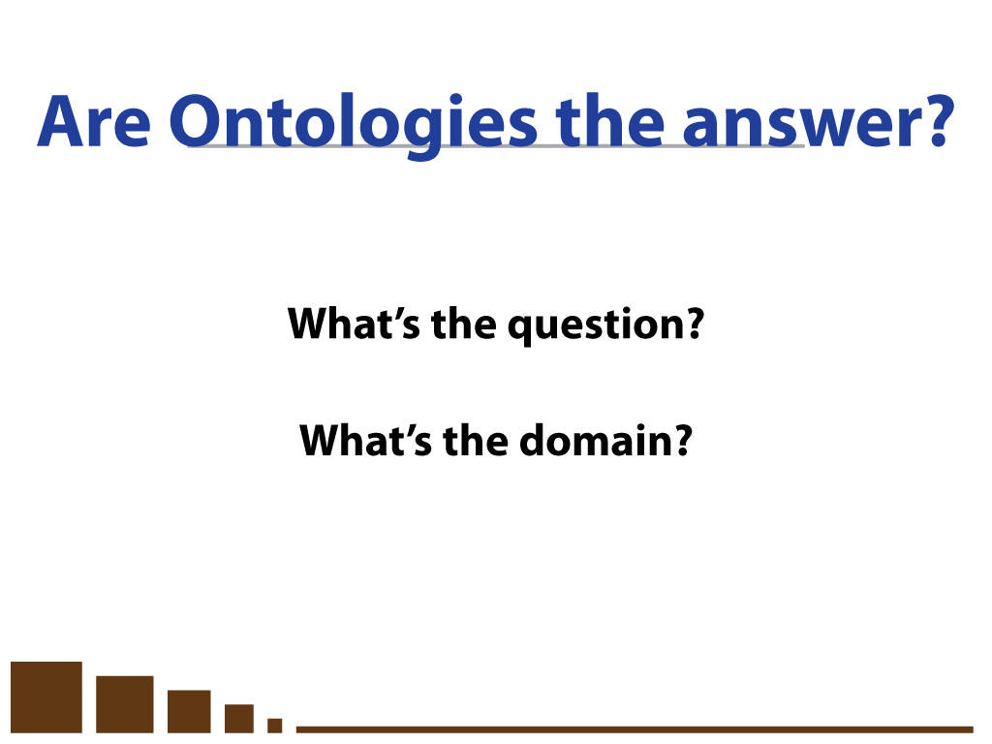

Slide 20
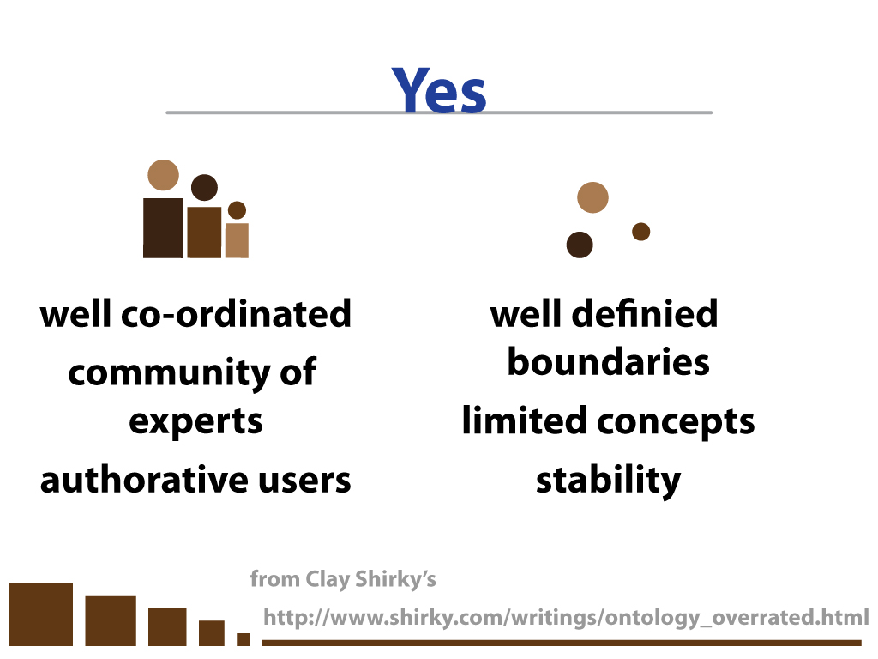

Slide 21
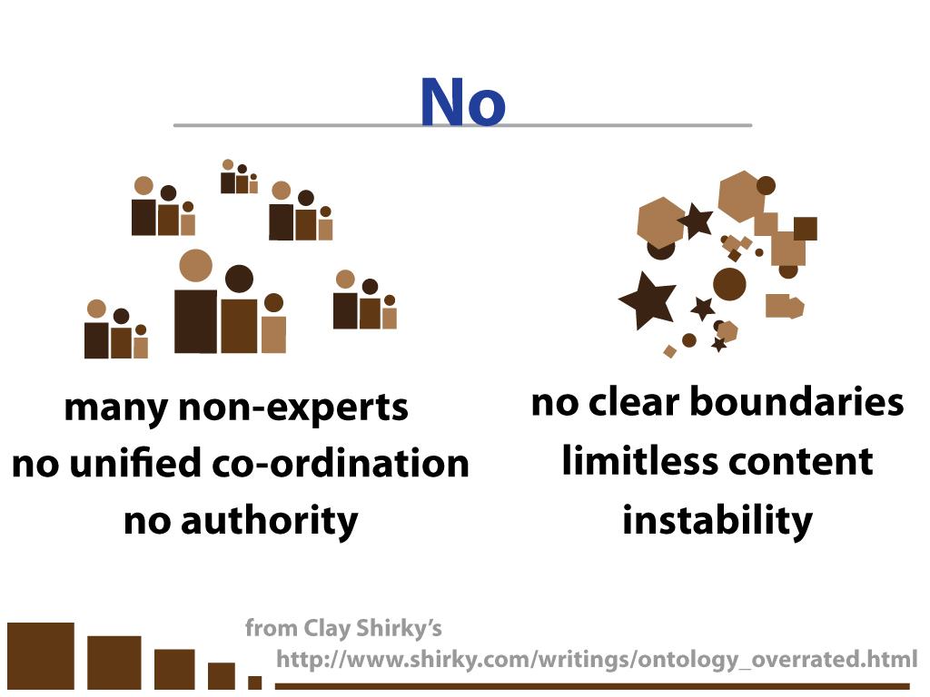

Slide 22
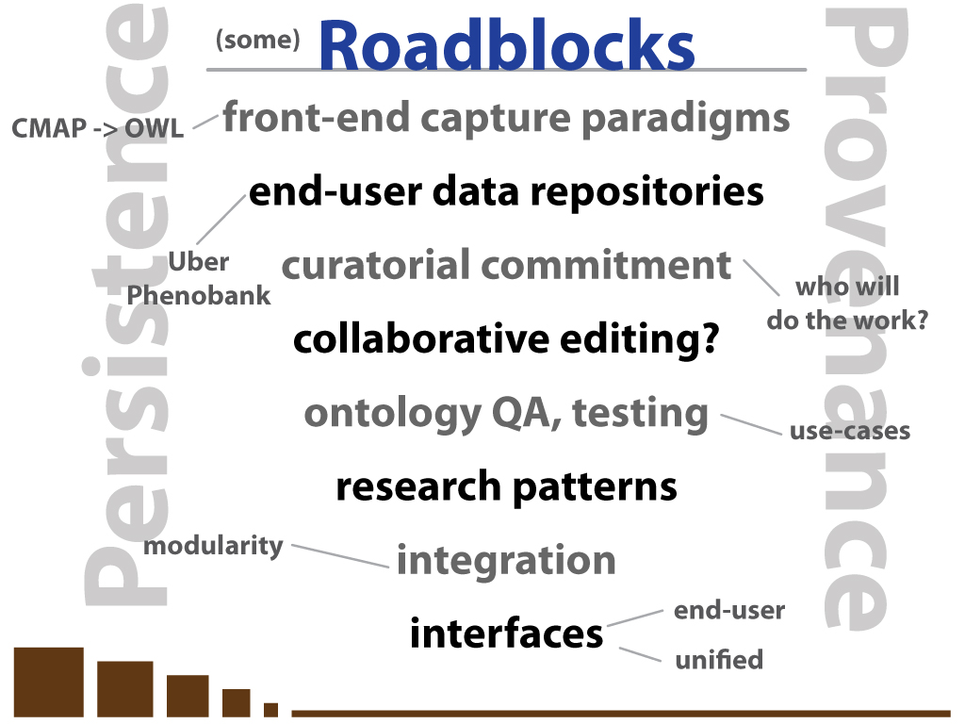

Slide 23
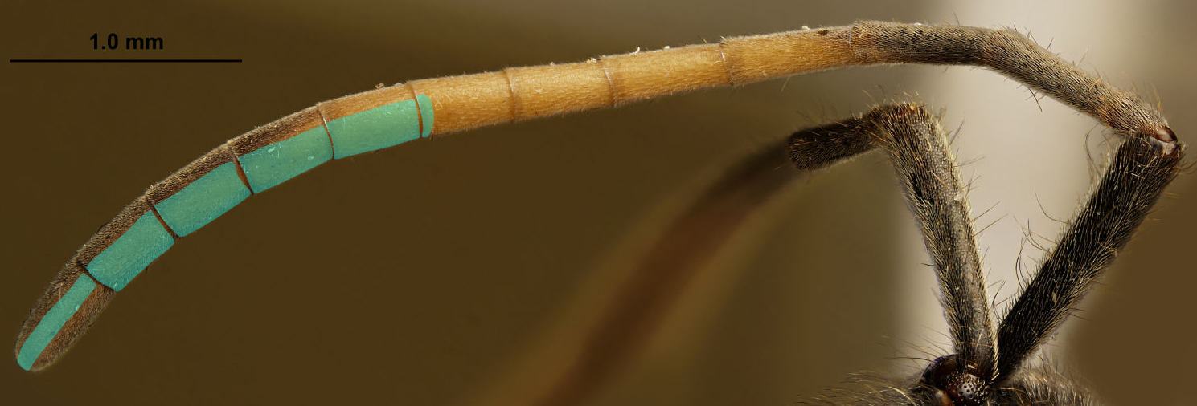
('has part' some ('flagellomere' and ('has part' some ('ventral region' and ('has part' some 'sensillar patch'))) and (distal_to exactly 3 'flagellomere'))) and ('has part' some ('flagellomere' and ('has part' some ('ventral region' and ('has part' some 'sensillar patch'))) and (distal_to exactly 4 'flagellomere'))) and ('has part' some ('flagellomere' and ('has part' some ('ventral region' and ('has part' some 'sensillar patch'))) and (distal_to exactly 5 'flagellomere'))) and ('has part' some ('flagellomere' and ('has part' some ('ventral region' and ('has part' some 'sensillar patch'))) and (distal_to exactly 6 'flagellomere')))
and ('has part' some ('flagellomere' and ('has part' some ('ventral region' and ('has part' some 'sensillar patch'))) and (distal_to exactly 7 'flagellomere'))) and ('has part' some ('flagellomere' and ('has part' some ('ventral region' and ('has part' some 'sensillar patch'))) and (distal_to exactly 8 'flagellomere'))) and ('has part' some ('flagellomere' and ('has part' some ('ventral region' and ('has part' some 'sensillar patch'))) and (distal_to exactly 9 'flagellomere'))) and ('has part' some ('apical flagellomere' and ('has part' some ('ventral region' and ('has part' some 'sensillar patch'))) and (distal_to exactly 10 'flagellomere')))

Slide 24
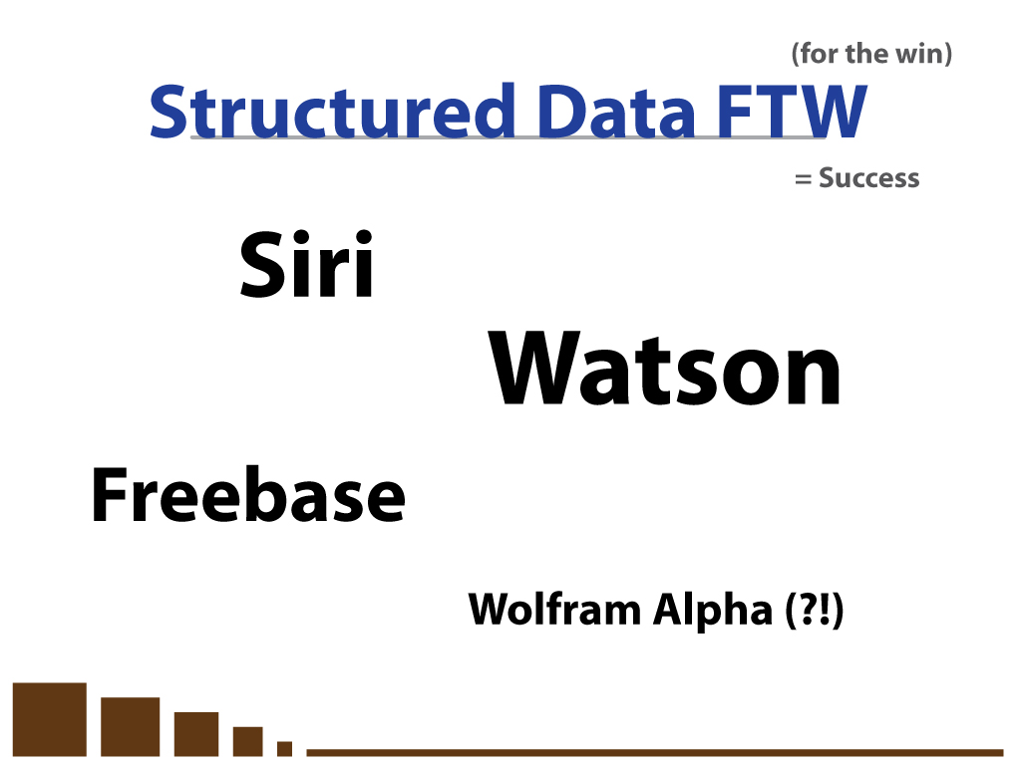

Slide 25
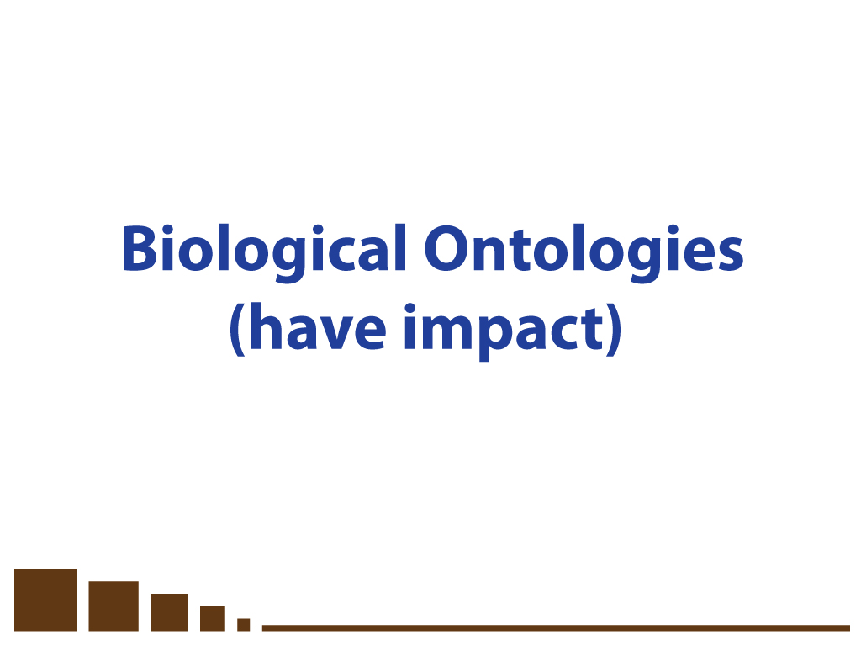

Slide 26
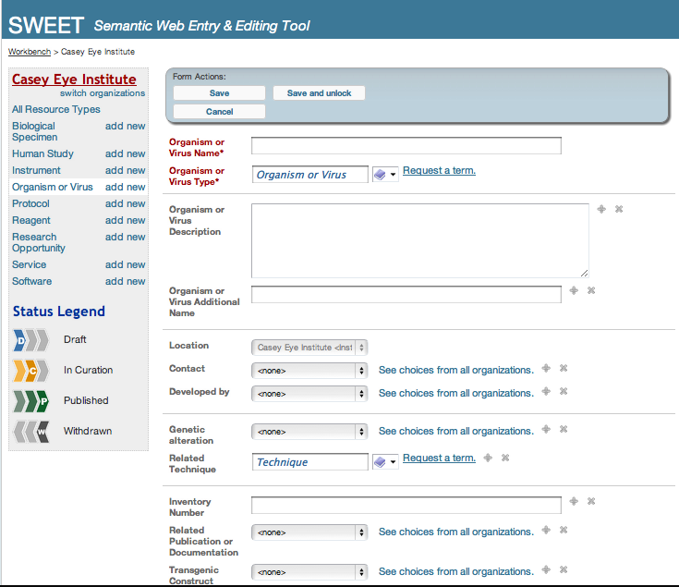
Driving a User Interface
eagle-i.net

Slide 27
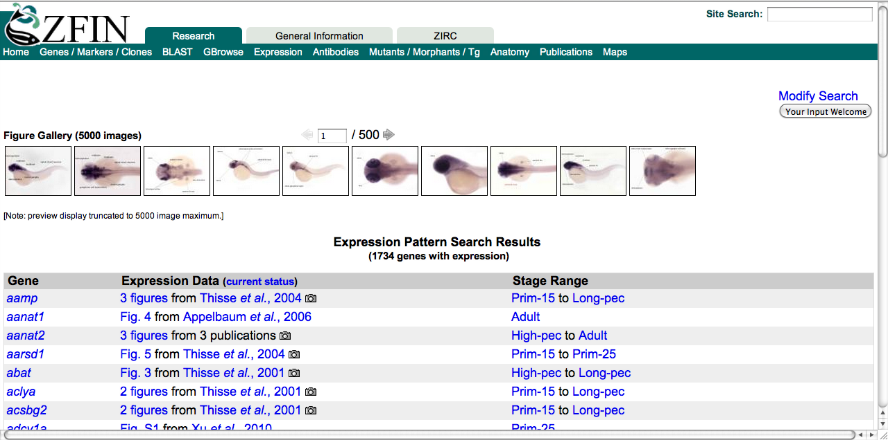
Querying anatomical data
zfin.org
Query for genes expressed in the retina and its parts:

Slide 28
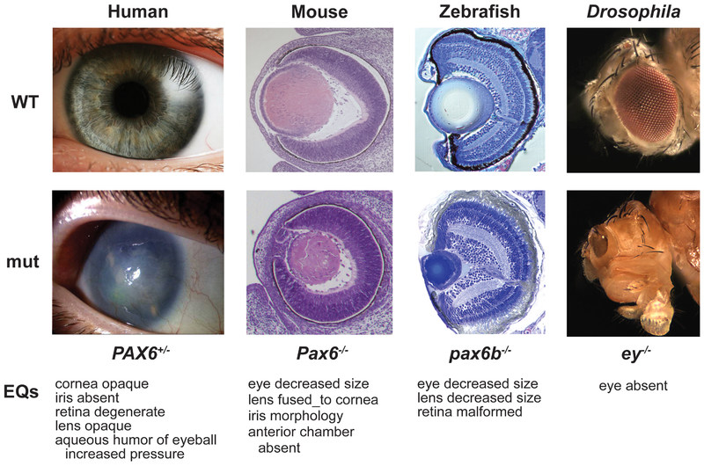
Semantic Similarity of Phenotypes
FMA+PATO
MP
ZFA+PATO
FBbt+PATO
"Linking Human Diseases to Animal Models Using Ontology-Based Phenotype Annotation." PLoS Biol 7(11): e1000247. doi:10.1371/journal.pbio.1000247 Washington NL, Haendel MA, Mungall CJ, Ashburner M, Westerfield M, Lewis SE

Slide 29
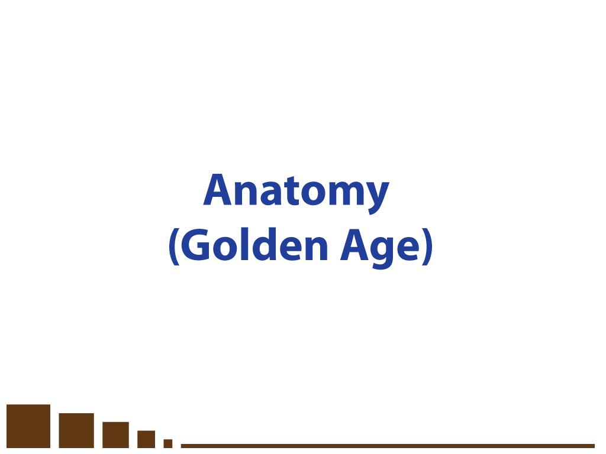

Slide 30
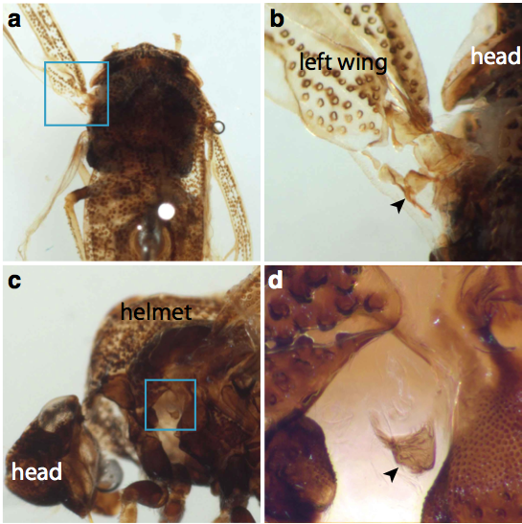
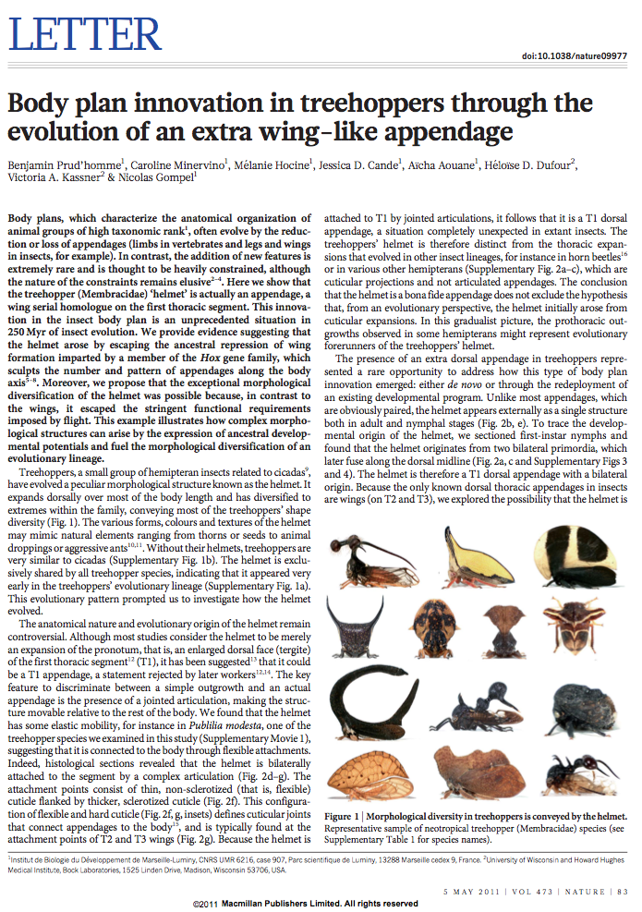
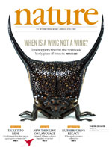
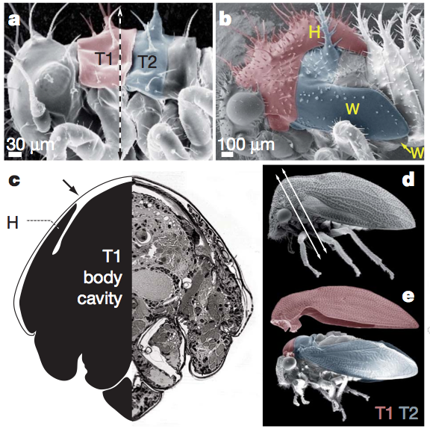
Facilitate explicitness, avoid misinterpretation

Slide 31
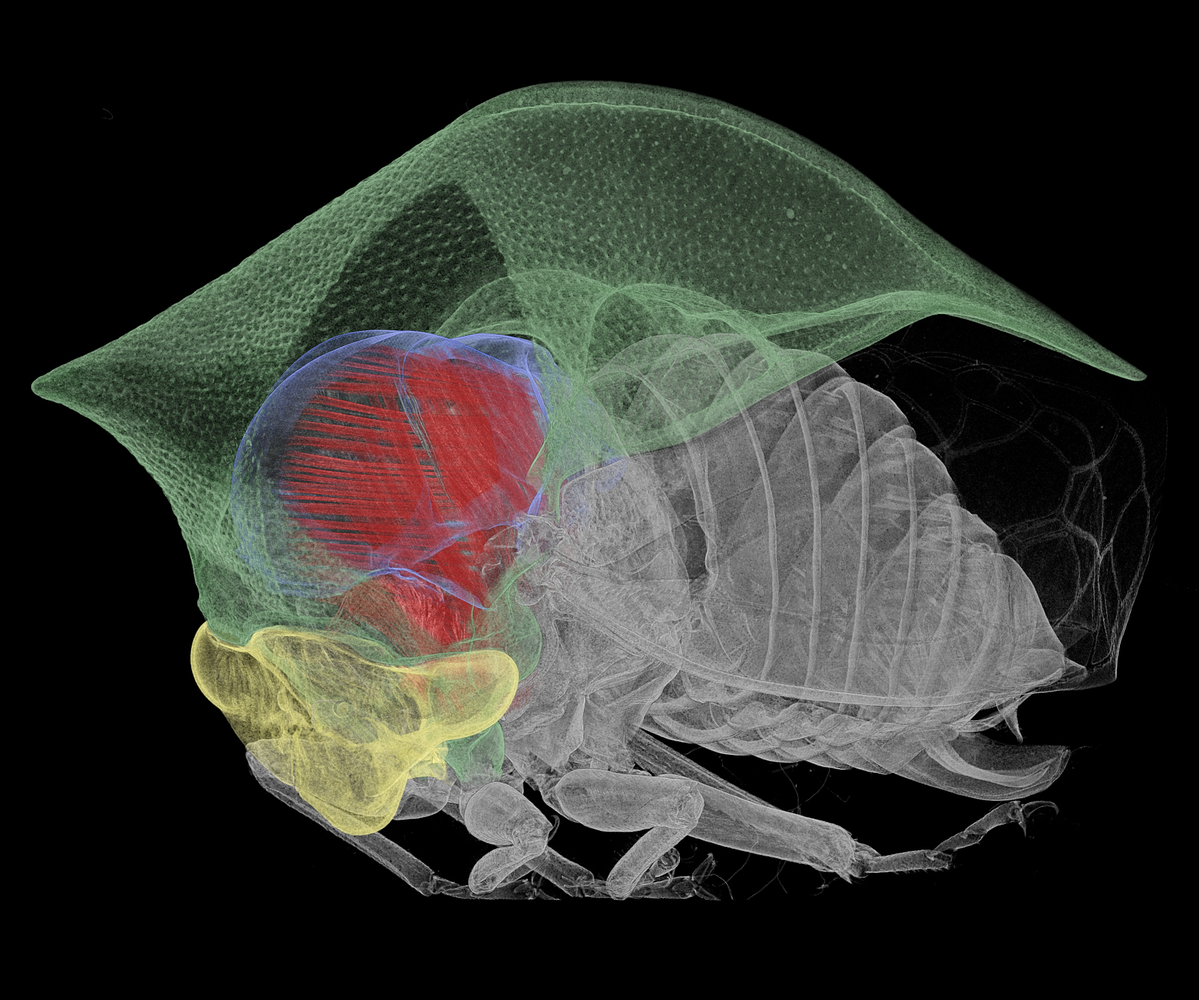

Slide 32
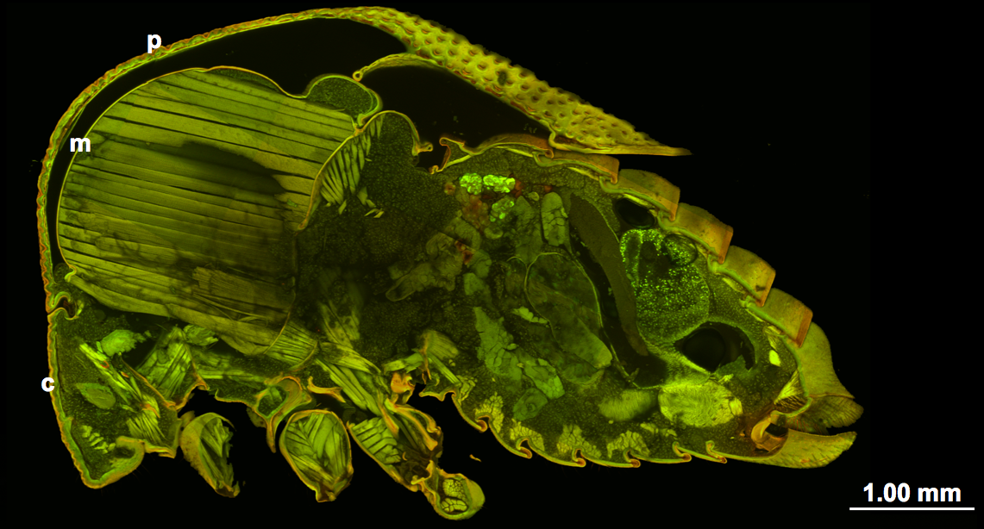
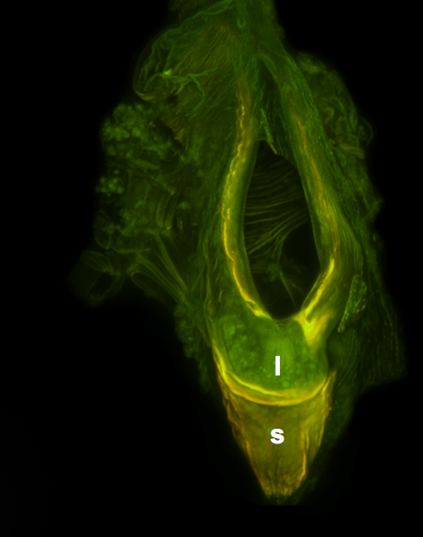
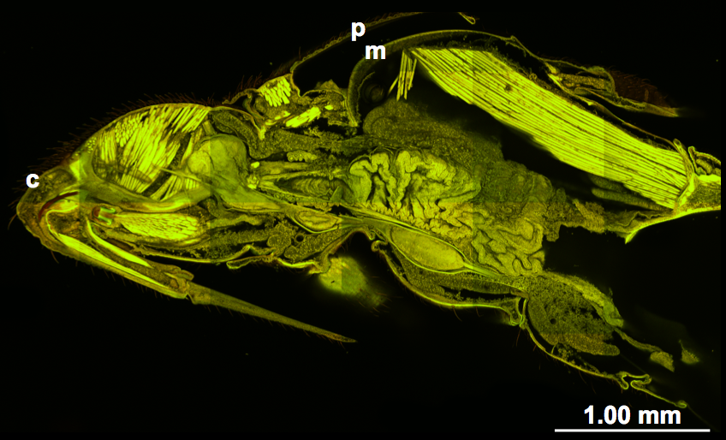

Slide 33
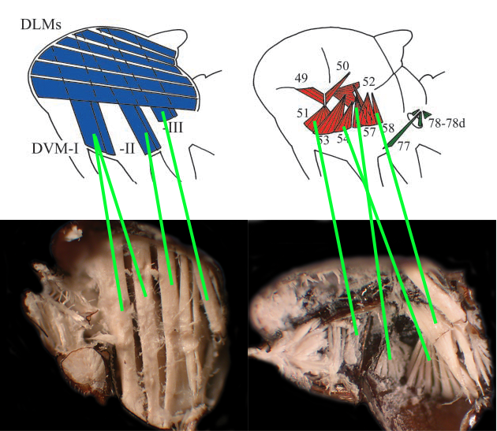

Slide 34
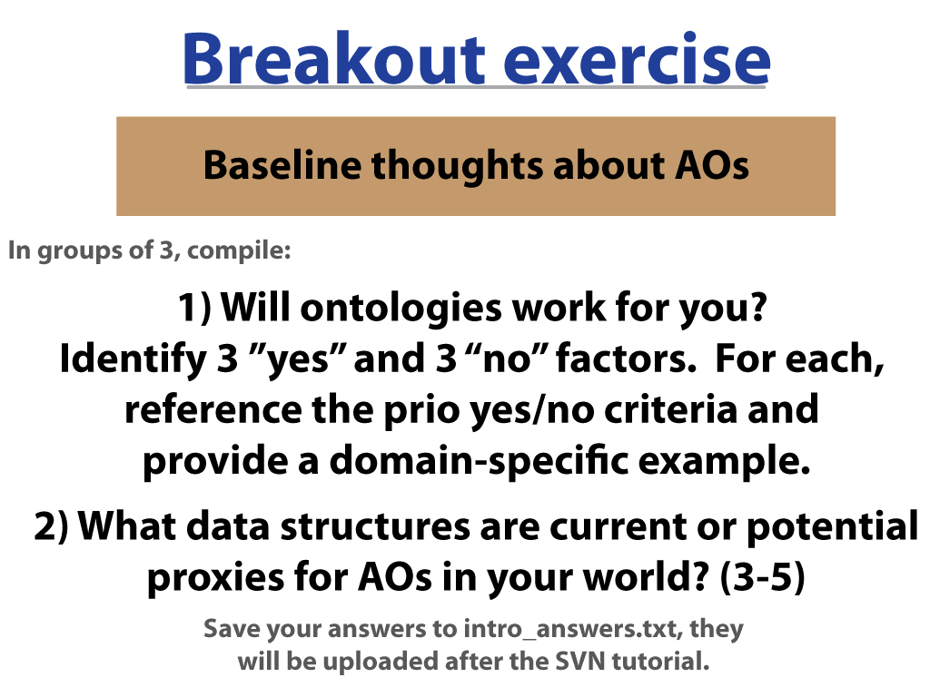

Slide 35
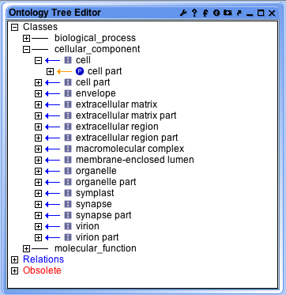

Ontology management
Editor
Subversion repository
Term tracker
Submit term request
Edit ontology
Deposit
Reports data changed due to ontology changes
Database
Database calls ontologies from repository
Notes:
Give this slide to matt for intro talk?

Slide 36
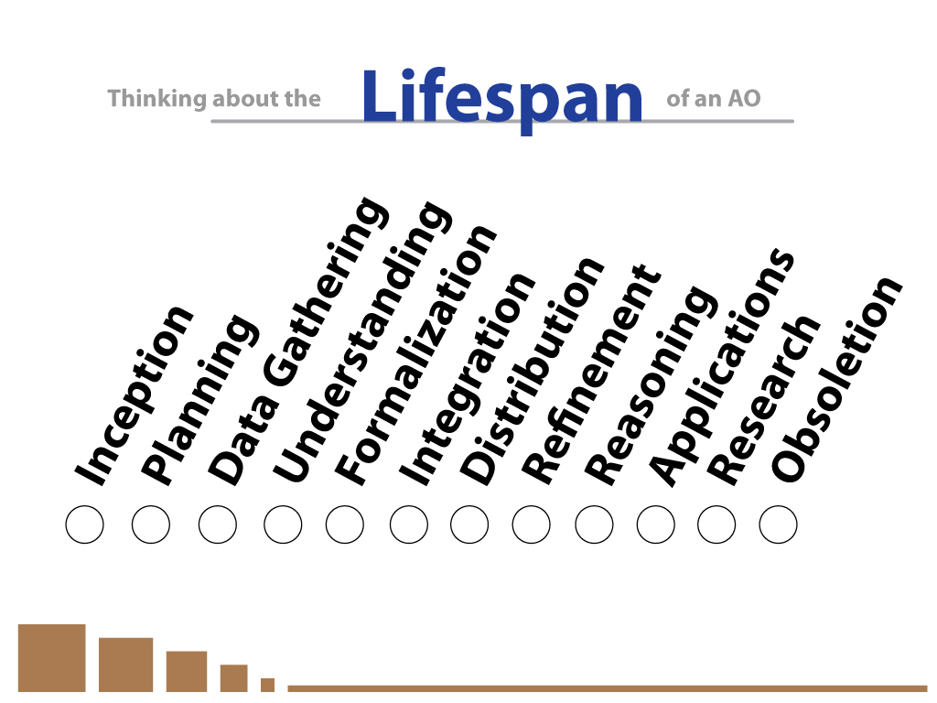

Slide 37
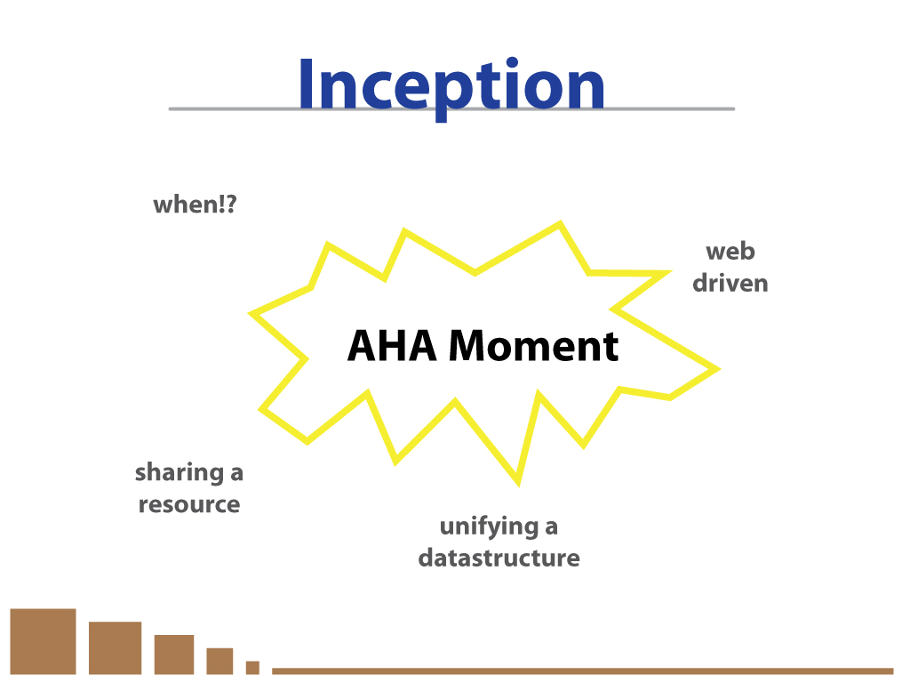

Slide 38
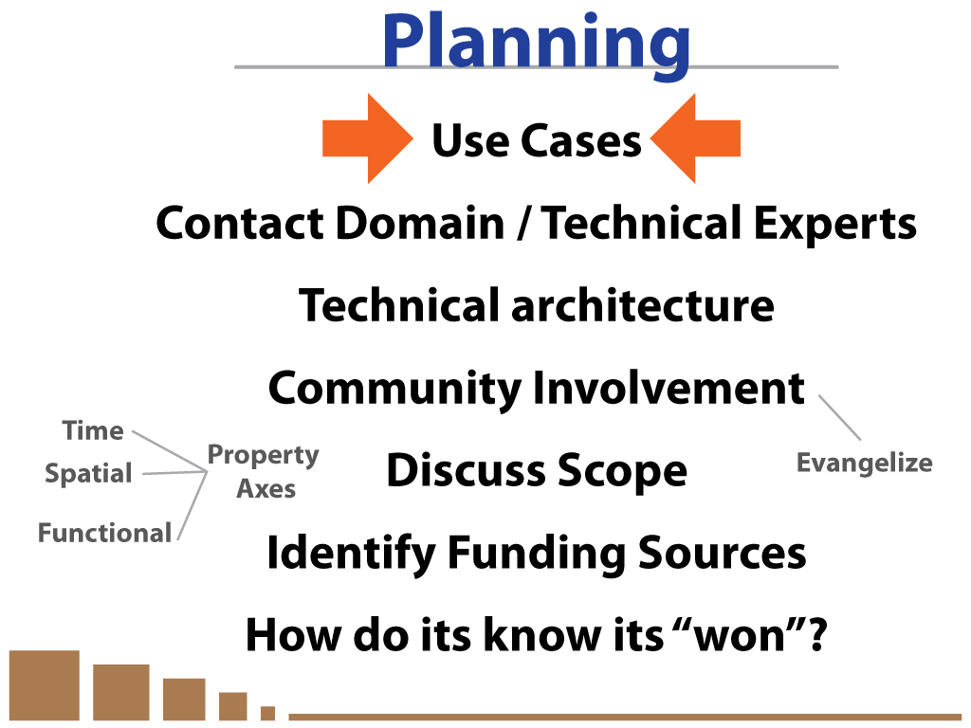

Slide 39
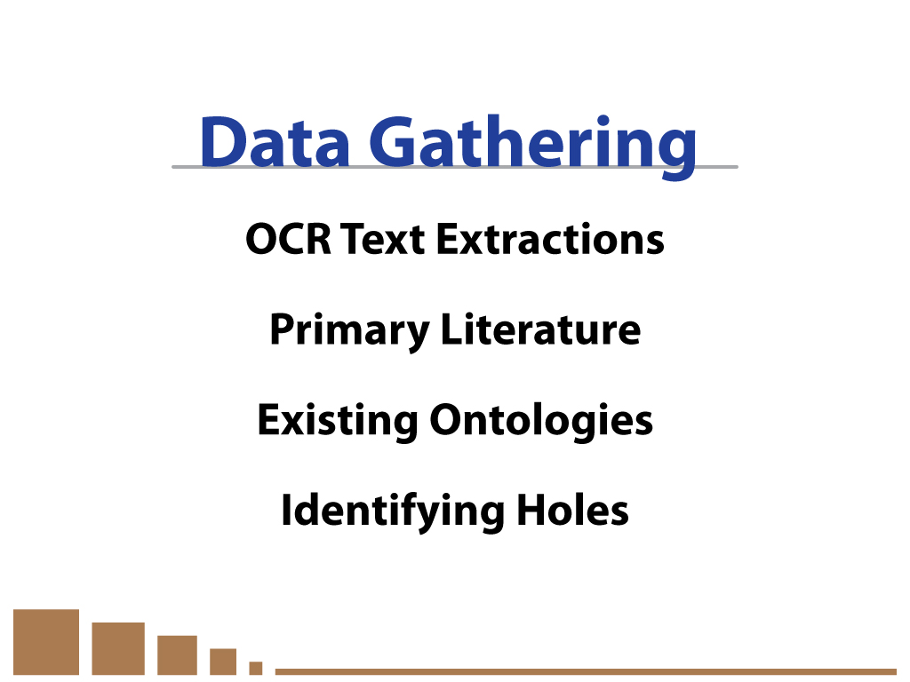

Slide 40
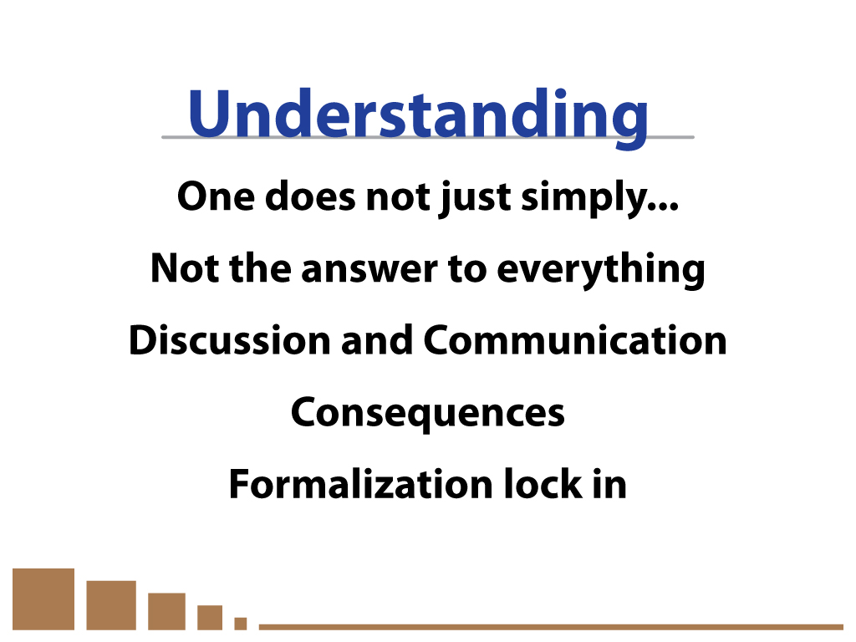

Slide 41


Slide 42


Slide 43


Slide 44


Slide 45


Slide 46


Slide 47


Slide 48


Slide 49


Slide 50


Slide 51



We want to enable:
Comparison of structures across different organisms, scales
Standardization of anatomical vocabulary among and between communities
Integration of anatomical data across databases
Query across large amount of data
Automatic reasoning to infer related classes
Error checking
Annotation consistency
Therefore, we build ontologies that are intelligible to:
Engineers
Domain experts
Ontologists
Machines
Notes:
Put in animated example of each of these.

Slide 52


Slide 55
Why do we need rules and standards for ontology use and construction?
Ontologies must be intelligible to both:
Humans
(for annotation and curation)
Machines
(for reasoning and error-checking)
Lack of rules for classification leads to human error and blocks automatic reasoning and error-checking
Intuitive rules facilitate training of annotators and ontology editors
Common rules allow alignment with other ontologies

Slide 56


Slide 57
Why ontology development is like software or database development
Ideal case:
maintainable
basic maintenance (e.g. correcting simple errors) is easy
scalable
grow your project as large as you need without breaking it
extensible
easy to add new functionality without breaking existing
integrate-able
Can integrate easily with work of others – so you don’t have to solve all problems yourself

Slide 58
Why ontology development is like software or database development
Ideal case - Future editors can build on your work
Maintainable –by multiple editors
basic maintenance (e.g. correcting simple errors) is easy
Scalable –by multiple editors
grow your project as large as you need without breaking it
extensible–by multiple editors
easy to add new functionality without breaking existing
integrate-able
Can integrate easily with work of others – so you don’t have to solve all problems yourself

